Slide 1

SECURING THE SUPPLY CHAIN : A BLOCKCHAIN BASED ANTI COUNTERFEITING FRAMEWORK
Rohit Chauhan Rutuja Choudhar Aditya Dharmadhikari
Harshwardhan Dhokane
Guide-Prof. Jayaprabha Kanase
Project Stage-II
PES Modern College of Engineering Department of Computer Engineering Savitribai Phule Pune University
10-June-2025
10-June-2025

Slide 2










Outline
Introduction Objectives and Scope Problem Statement Literature survey Architectural Diagram System Specifications Actual Results
Conclusion
Papers Published and Participation in Project Competition References
1
2
3
4
5
6
7
8
9
10
10-June-2025

Slide 3
Introduction
1.1 Overview What is it? This project uses Blockchain, a new technology, to help confirm if products are real without needing a central system. How does it work? Blockchain ensures that once information is recorded, it cannot be changed by anyone. Our Goal: We use Blockchain to create a system where customers can easily check if a product is genuine without needing a store to verify it. Benefits: This system helps manufacturers and companies make their products harder to copy, building more trust with customers. We built our system using the Ethereum blockchain to track every item's creation and journey, ensuring its authenticity
10-June-2025

Slide 4
Objectives and Scope
OBJECTIVES
1.For Manufacturers:
Create a secure platform to manage seller registrations.
See live sales to make sure everyone is doing their job right.
Allow consumers to check product authenticity using secured QR code.
2.For Sellers/Retailers:
Sellers can lock their info with a secret username and password.
Allow sellers/retailers to update sales records.
Give full access to product details and sales results.
3.For Consumers:
Help consumers verify if sellers are real and if products are in stock.
Enable consumers to access their purchase history and product status.
Increase transparency and trust-worthiness with the customers.
10-June-2025

Slide 5
Objectives and Scope
Project Scope
Apply a blockchain + QR code solution specifically to luxury products.
Cover the entire supply chain: manufacturing, shipping, retail, and customer verification.
Enable brands to tag each luxury item with a unique, scannable identity.
Ensure transparency and traceability in every stage of a product’s journey.
Help customers verify authenticity before purchase—instantly and securely.
10-June-2025

Slide 6
Problem Statement
Problem Statement
To develop a blockchain-based anti-counterfeiting framework that enhances supply chain transparency, traceability, and data integrity to tackle counterfeiting challenges across industries, while addressing scalability, privacy, implementation costs, and user adoption to restore trust among consumers and manufacturers.
10-June-2025

Slide 7
Literature Survey(1/2)
Title | Author, Publisher, Year | Techniques | Remark
1.High-Efficiency Blockchain-Based Supply Chain Traceability | Hanqing Wu, Shan Jiang, Jiannong Cao, IEEE Transactions on Intelligent Transportation Systems, 2023 | Blockchain, Parallel Search Algorithms, Bipartite Graph Modeling | This paper discusses applications of blockchain to improve supply chain traceability and combat counterfeiting .
2.PharmaChain: A Blockchain to Ensure Counterfeit-Free Pharmaceutical Supply Chain | A.K. Bapatla, S.P. Mohanty, E. Kougianos, D. Puthal, A. Bapatla; IET Networks, 2023 | Blockchain, Smart Contracts, Pharmaceutical Supply Chain. | Develop blockchain system to combat counterfeit drugs in pharmaceutic al industry.
Table 1:-Literature Survey
10-June-2025

Slide 8
Literature Survey(2/2)
Title | Author, Publisher, Year | Techniques | Remark
3.Blockchain & IOT in Smart Cities, Drug Supp Management: Open Issues, Opportunities, and Future Directions. | H. Malik, T. Anees, M. Faheem, M.U. Chaudhry, A. Ali, M.N. Asghar; Internet of Things, 2023 | Blockchain, Internet of Things (IoT), Smart Cities, Drug Supply Management. | Explores the integration of blockchain and IoT in smart cities and drug supply chains.
4. Transparent and Traceable Food Supply Chain Management | Narayan Subramanian, Atharva Joshi, Daksh Bagga; arXiv, 2023 | Blockchain, Digital Ledger, Product Traceability. | Dev blockchain syst to enhance transparency and traceability in food supply chain.
Table 2:-Literature Survey
10-June-2025

Slide 9
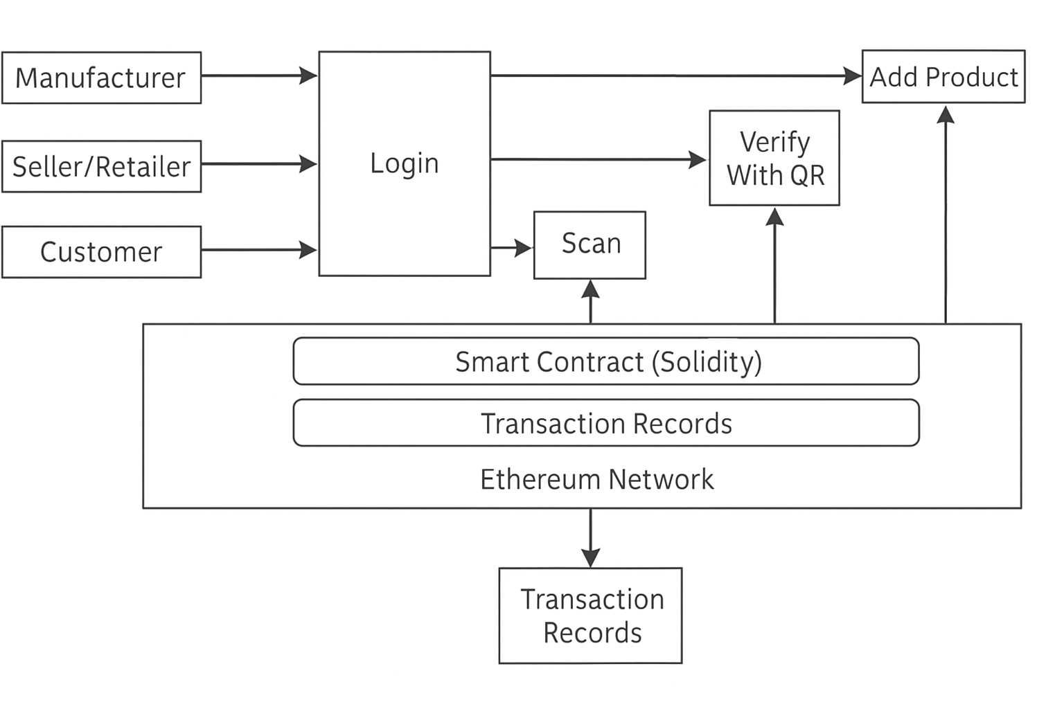
Architectural Diagram
Figure: 1.System Architectural Diagram.
10-June-2025

Slide 10
Architectural Diagram
1. Manufacturer:
● Registration: The manufacturer registers on the platform.
● Login: The manufacturer logs in to manage product information
add new products to the blockchain.
● Add Product: The manufacturer adds product details (name,
description, QR code, etc.) to the blockchain.
2. Seller/Retailer:
● Registration: The seller registers on the platform.
● Login: The seller logs in to verify product authenticity and update
product details.
● Update Details: The seller can update product details (e.g.,location
price) on the blockchain.
3. Customer:
● Scan: The customer scans the QR code on the product using the
platform's app or website.
● Verify with QR: The scanned QR code is verified against the
blockchain data to ensure product authenticity.
System Architectural Explanation.
10-June-2025

Slide 11
System Specifications
The Software Requirements of the system are:-
Sr.no | Software | Description
1 | Operating System | Windows OS / Mac OS
2 | Language Used For Implementation | Solidity
3 | Development Environment | React.js
4 | Smart Contract Dev Environment | Hardhat (for smart contract testing)
Table: 5.Software Requirements
The Hardware Requirements of the system are:-
Sr.no | Hardware | Description
1 | RAM | 4GB and above
2 | Processor | intel CORE i3 and above
Table: 6.Hardware Requirements
10-June-2025

Slide 12
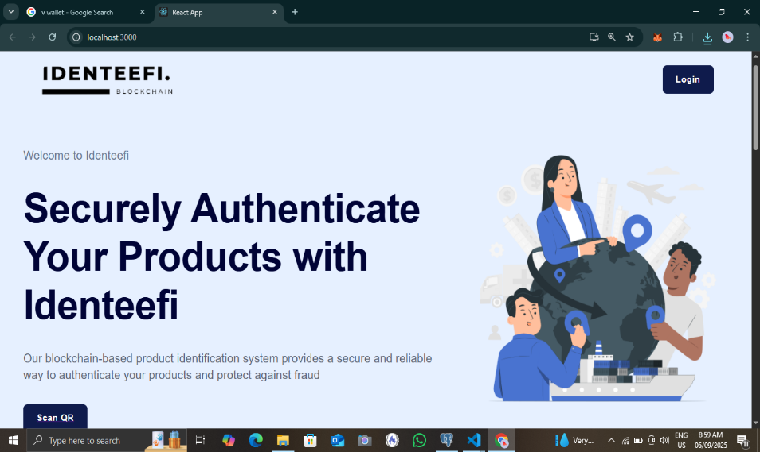
Result(1/6)
10-June-2025

Slide 13
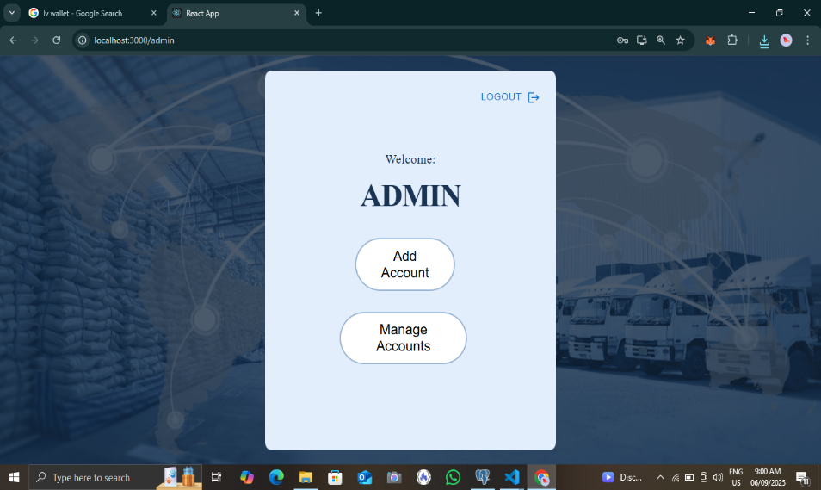
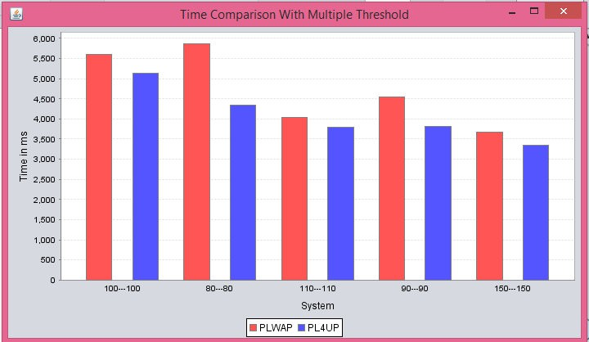
Result(2/6)
10-June-2025

Slide 14
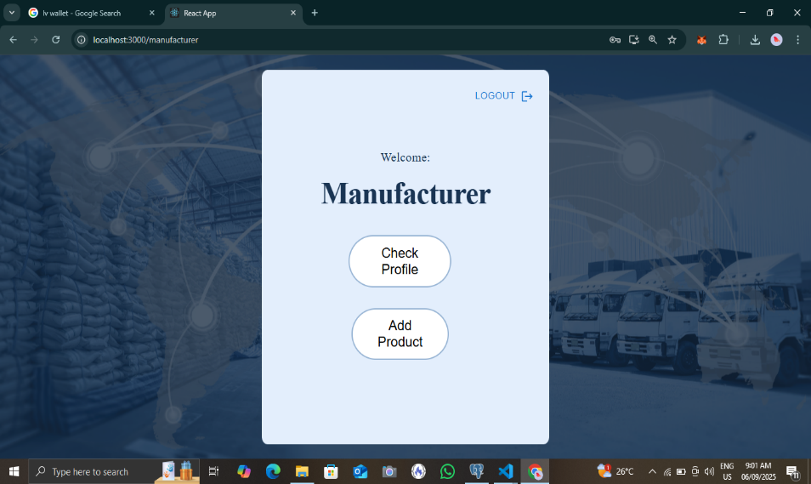
Result(3/6)
10-June-2025

Slide 15
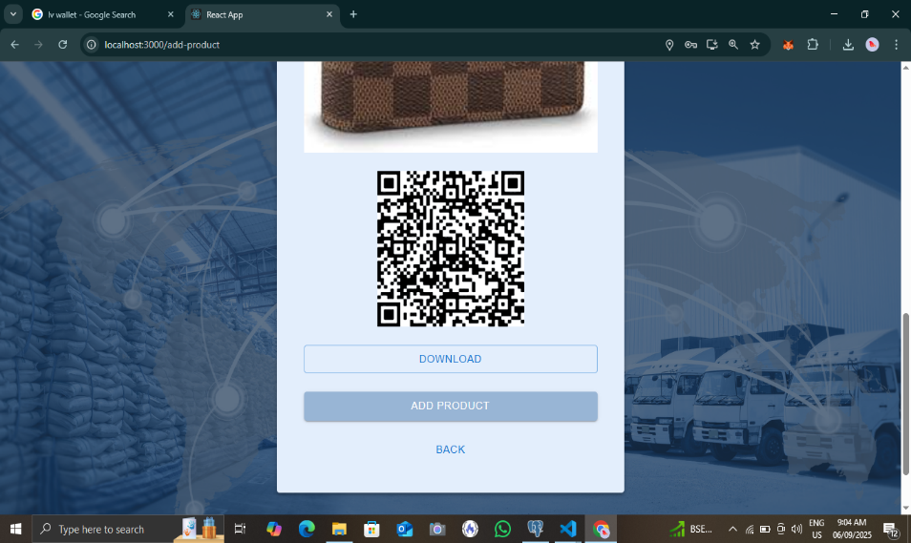
Result(4/6)
10-June-2025

Slide 16

Result(5/6)
.
10-June-2025

Slide 17
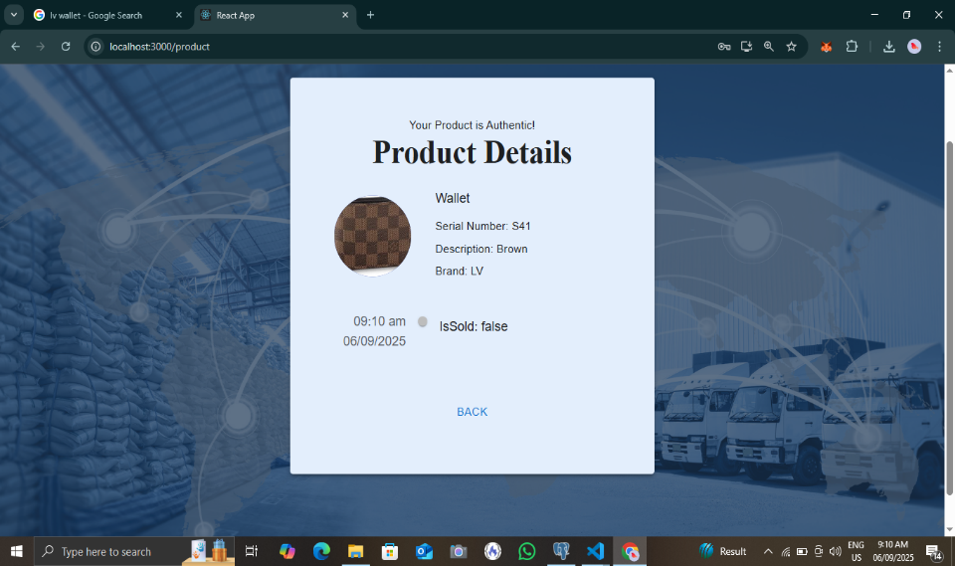
Result(6/6)
.
10-June-2025

Slide 18
Conclusion
Implementing a blockchain-based anticounterfeiting framework significantly strengthens supply chain security by providing transparent, traceable, and immutable records that safeguard product authenticity.
This technology is especially advantageous in industries where counterfeiting risks are high, such as pharmaceuticals, luxury goods, and electronics, enhancing consumer confidence and brand trust.
Blockchain gives everyone involved a reliable way to fight fake products and keep the supply chain honest in today's tough global market.
10-June-2025

Slide 19
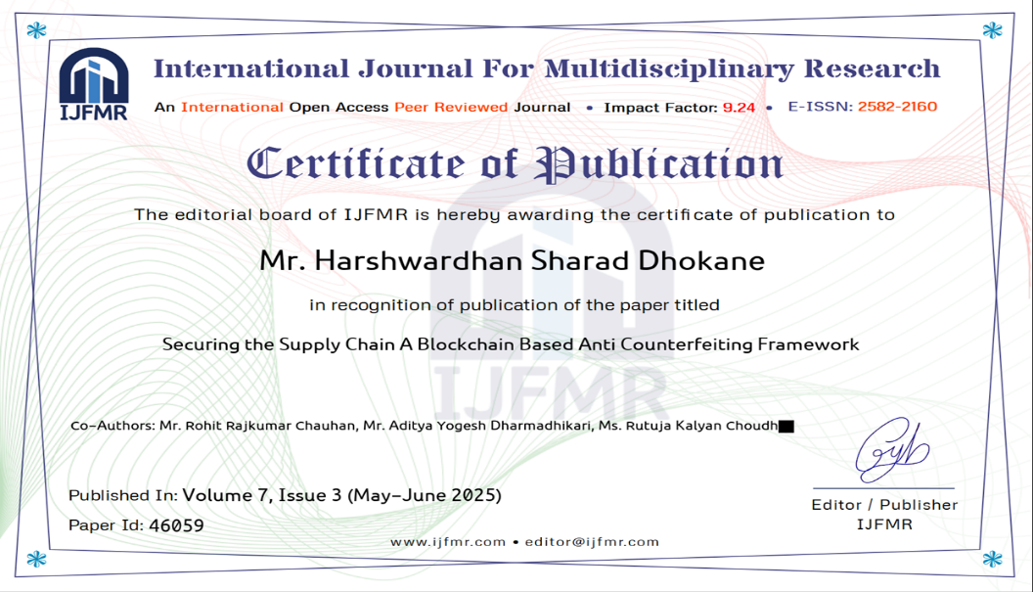
Papers Published and Participation in Project Competition
Survey On: Web Usage Mining Techniques Generating Frequent Patterns for Web-Page Recommendation,”International Journal of Computer Science and Information Technologies, Vol. 7 (3) , 2016, 1435-1437”.
Integrating PL4UP a Fast Sequence Pattern Mining Algorithm with Ontology for Web-Page Recommendation,”CPGCON 2016”.
10-June-2025

Slide 20
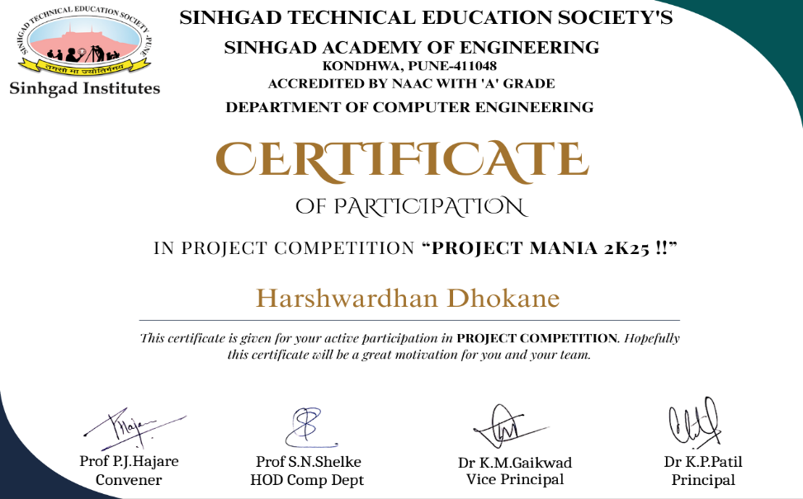
Papers Published and Participation in Project Competition
10-June-2025

Slide 21
References I
1. Gokuleshwaran Narayan, Ivan Cvitic, Dragan Perakovic, S.P. Raja,
Role of Blockchain Technology in Supplychain Management.
2. Shashank Gupta, An Ethereum-based Product Identification System for Anti-counterfeits.
3. Nafisa Anjum, Pramit Dutta, Identifying Counterfeit Products using Blockchain Technology in Supply Chain System (2022).
4. Shubham Prajapati, Jayesh Gadhari, Tushar Sawant, Juilee Kini, Sheetal Solanki, (2023), Strengthing Supply Chain Integrity with Blockchain-based Anti-Counterfeiting Measures.
5. JINHUA MA, SHIH-YA LIN, XIN CHEN, HUNG-MIN SUN, YEH-CHENG CHEN, (Graduate Student Member, IEEE) and HUAXIONG WANG, (2020): A Blockchain-Based Application System for Product Anti-Counterfeiting.
10-June-2025

Slide 22
References II
G. Wood, ‘‘Ethereum: A secure decentralised generalised transaction ledger,’’ Ethereum Project Yellow Paper, vol. 151, p. 1–32, Apr. 2014.
S. Panikkar, S. Nair, P. Brody, and V. Pureswaran, ‘‘ADEPT: An IoT practitioner perspective,’’ IBM Inst. Bus. Value, New York, NY, USA, White Paper, 2015, pp. 1– 1.
(2018). Tzero. [Online]. Available: https://www.tzero.com/
Anthony, Michael Christian Lee, Rafaelle Richel Pearl, Ivan Sebastian Edbert, Derwin Suhartono, (2022), Developing an anti-counterfeit system using blockchain technology.
(2018). Hyperledger. [Online]. Available: https://www.hyperledger.org/
10-June-2025

Slide 23

10-June-2025

